Slide 1
Computer Vision (SPRING 2019) Problem Set #2
Jijun HU
jijun.hu.0930@gatech.edu
Computer Vision @ GT

Slide 2
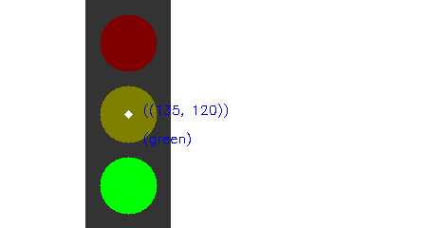
Traffic Light Detection
Coordinates and State:
Coordinates - (135,120)
State - green
ps2-1-a-1.png

Slide 3
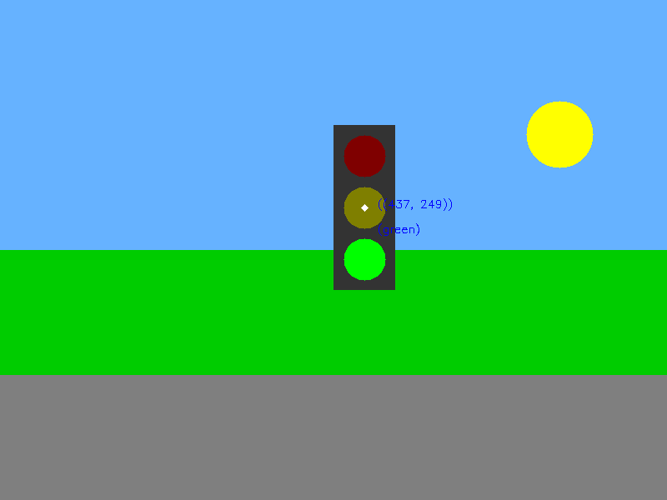
Traffic Light Detection
Coordinates and State:
Coordinates – (437, 249)
State - green
ps2-1-a-2.png

Slide 4
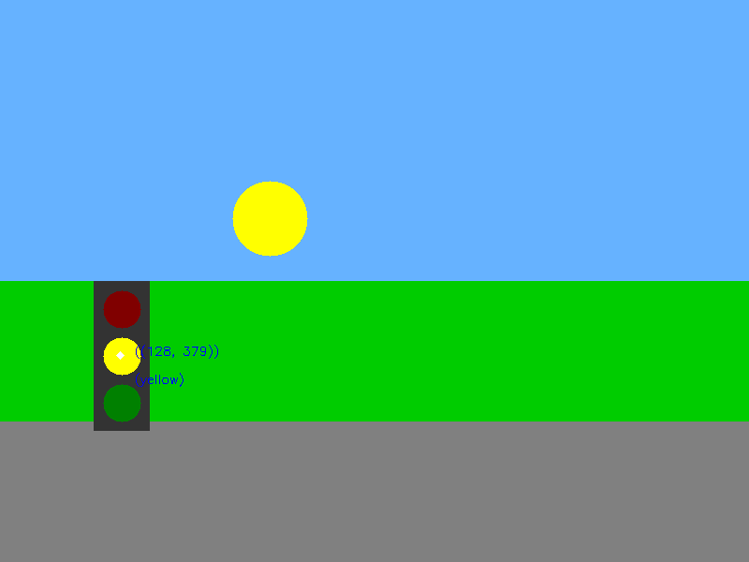
Traffic Light Detection
Coordinates and State:
Coordinates – (128, 379)
State - yellow
ps2-1-a-3.png

Slide 5

Traffic Light Detection
Coordinates and State:
Coordinates – (628, 479)
State - red
ps2-1-a-4.png

Slide 6

Traffic Sign Detection - Do Not Enter
Coordinates:
Coordinates – (245, 345)
ps2-2-a-1.png

Slide 7

Traffic Sign Detection - Stop
Coordinates:
Coordinates – (549, 248)
ps2-2-a-2.png

Slide 8
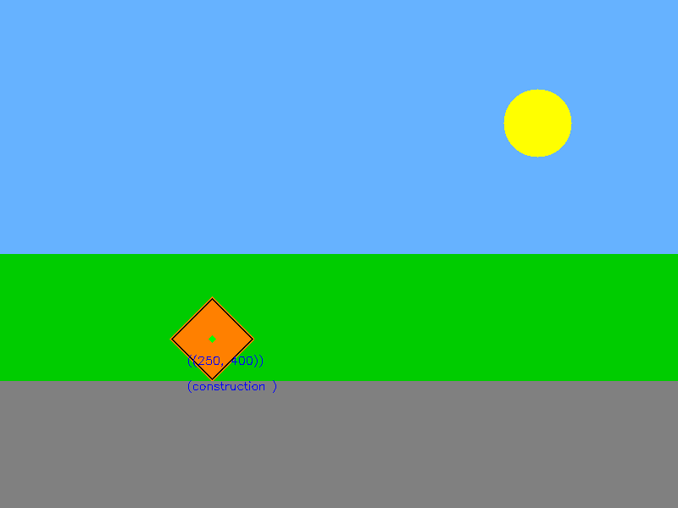
Traffic Sign Detection - Construction
Coordinates:
Coordinates – (250, 400)
ps2-2-a-3.png

Slide 9

Traffic Sign Detection - Warning
Coordinates:
Coordinates – (748, 349)
ps2-2-a-4.png

Slide 10

Traffic Sign Detection - Yield
Coordinates:
Coordinates – (306, 182)
ps2-2-a-5.png

Slide 11
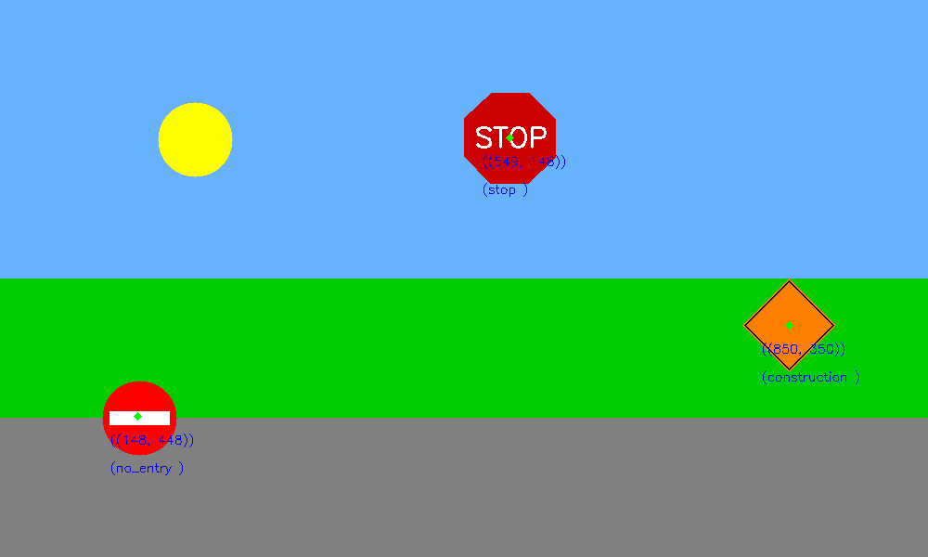
Multiple sign detection
Coordinates and Names
no entry – (148, 448)
Stop – (549, 148)
construction – (850, 350)
ps2-3-a-1.png

Slide 12
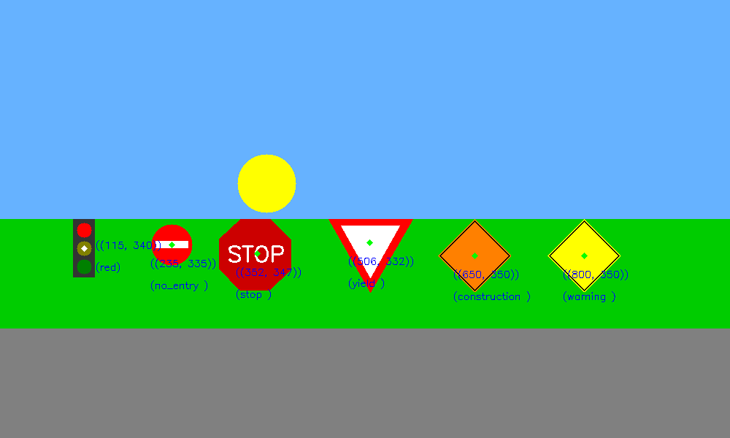
Multiple sign detection
Coordinates and Names
Traffic light – (115, 340), ‘red’
No entry – (235, 335)
Stop – (352, 347)
Yield – (506, 332)
Construction – (650, 350)
Warning – (800, 350)
ps2-3-a-2.png

Slide 13
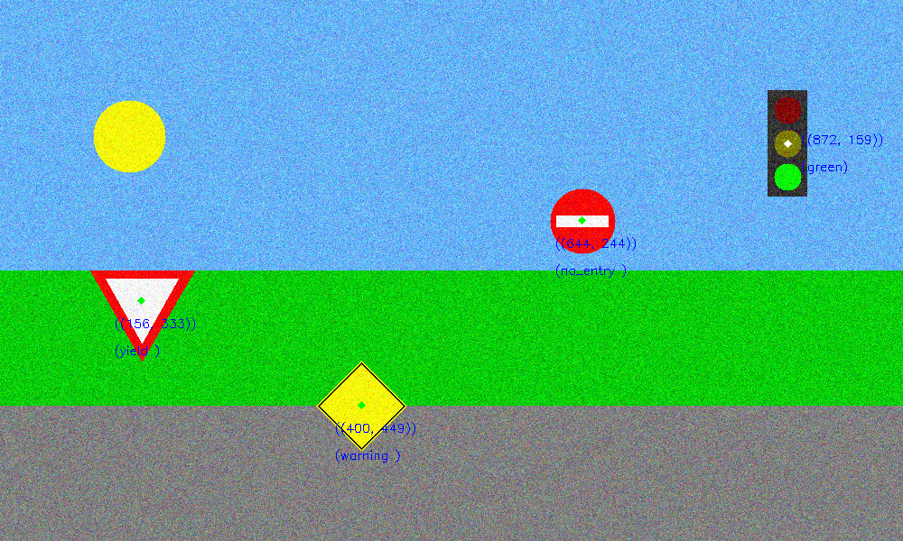
Multiple sign detection with noise
Coordinates and Names
Traffic light – (872, 159), ‘green’
No entry – (644, 244)
Yield – (156, 333)
Warning – (400, 449)
ps2-4-a-1.png

Slide 14
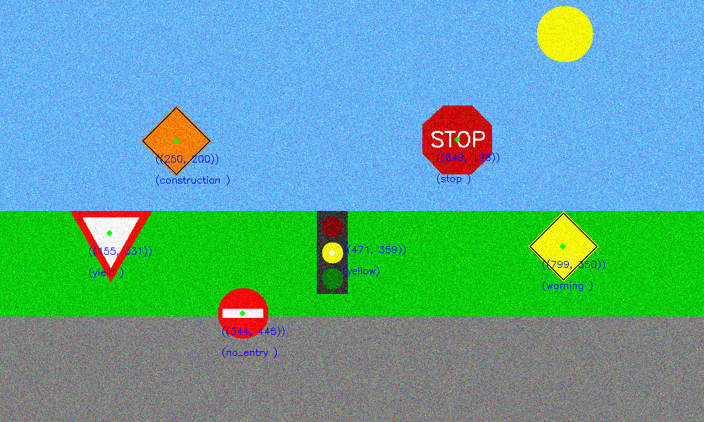
Multiple sign detection with noise
Coordinates and Names
Traffic light – (471, 359), ‘yellow’
No entry – (344, 445)
Stop – (649, 198)
Yield – (155, 331)
Construction – (250, 200)
Warning – (799, 350)
ps2-4-a-2.png

Slide 15
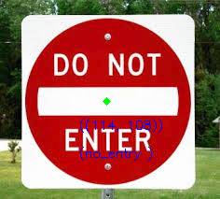
Challenge problem - A
Do not Enter:
(114, 108)
ps2-5-a-1

Slide 16
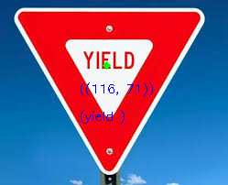
Challenge problem - A
Yield
(116, 71)
ps2-5-a-2

Slide 17

Challenge problem - A
Coordinates and Name:
ps2-5-a-3

Slide 18
Challenge problem - B
Coordinates and Name:
ps2-5-b-1

Slide 19
Challenge problem - B
Coordinates and Name:
ps2-5-b-2

Slide 20
Challenge problem - B
Coordinates and Name:
ps2-5-b-3

Slide 21
Challenge problem - Text
Describe what you had to do to adapt your code for this task. How does the difference between simulated and real-world images affect your method? If you used other functions/methods, explain why that was better (or why your previous implementation did not work)
I feel the real image do contain much more noise in the image, and because when taking the photo, we always have different angles, that makes my conditions in my initial implementation too strong, I tried to loose to restriction a lot, but still cannot make it work for all the signs in different situation.

